Slide 1
Member segmentation classification & driving behavior prediction
Blake Abbenante
4/11/16

Slide 2
overview
GOAL:
Create repeatable (automated) process for segmenting North American Zipcar Members that will allow marketing:
Target subgroups of the member base
Judge the effectiveness of the marketing efforts
HOW:
Identify the factors that are key indicators to a member’s future behavior
Understand the likelihood of a given member to drive in a predetermined timeframe.
Understand the number of trips a given member is likely to take in a predetermined timeframe.

Slide 3
METHODOLOGY
Data exploration
Feedback
Model
Validate

Slide 4
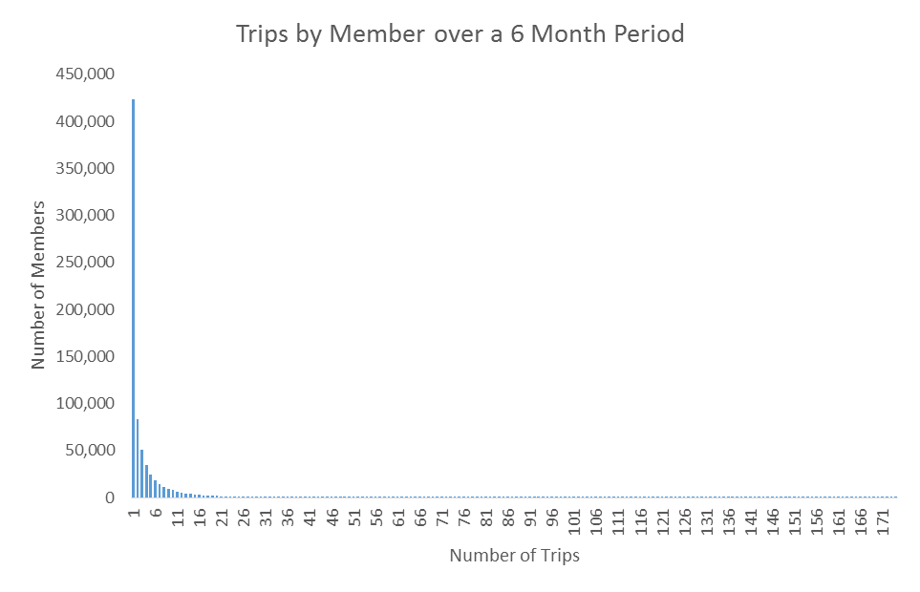
Data exploration
For any given month, there is a negative exponential distribution of the aggregate rental pattern for the next six months

Slide 5
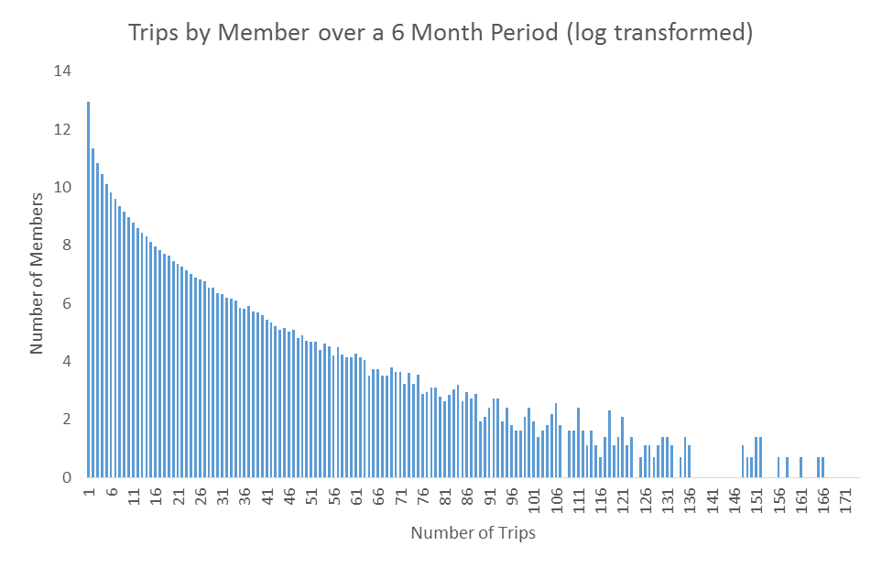
Data exploration
Transforming the number of members gives us a linear relationship between number of members and number of trips

Slide 6
Data exploration
Over a 25 month period, the average correlation coefficient was -0.91
In aggregate, member behavior is quite reliable, perhaps even predictable.
The ‘edges’ are where the variance occurs

Slide 7
Data exploration - rfm
RFM – a common segmentation strategy in retail/catalog marketing. Score all members across three dimensions:
R(ecency) – When did the member last drive
F(requency) – How often does the member drive
M(onetary) – When the member drives, how much do they spend
For a given month, look at the member’s previous 12 months activity and give them a score of 1-3 in each of the categories

Slide 8
Data exploration - rfm
Recency:
3 – Made a reservation in the previous month
2 – Made a reservation in the previous 2-6 months
1 – Made a reservation in the previous 7-12 months
Frequency:
3 – Reservations in 7-12 of the previous 12 months
2 – Reservations in 3-6 of the previous 12 months
1 – Reservations in 1 or 2 of the previous 12 months
Monetary:
3: Avg Monthly revenue > $100
2: Avg Monthly revenue<$100 and >$50
1: Avg Monthly revenue<$50
New Members were given a classification of 0
Non Active members were given a classification of 9

Slide 9
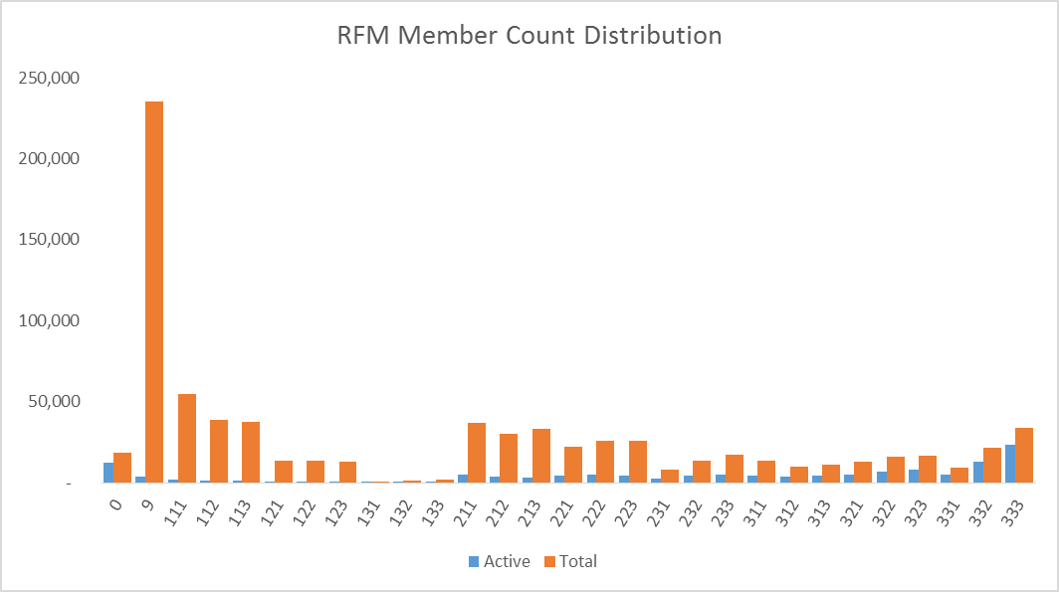
Data exploration – member distribution
The chart shows the total and active members for each segmentation group for January 2016

Slide 10
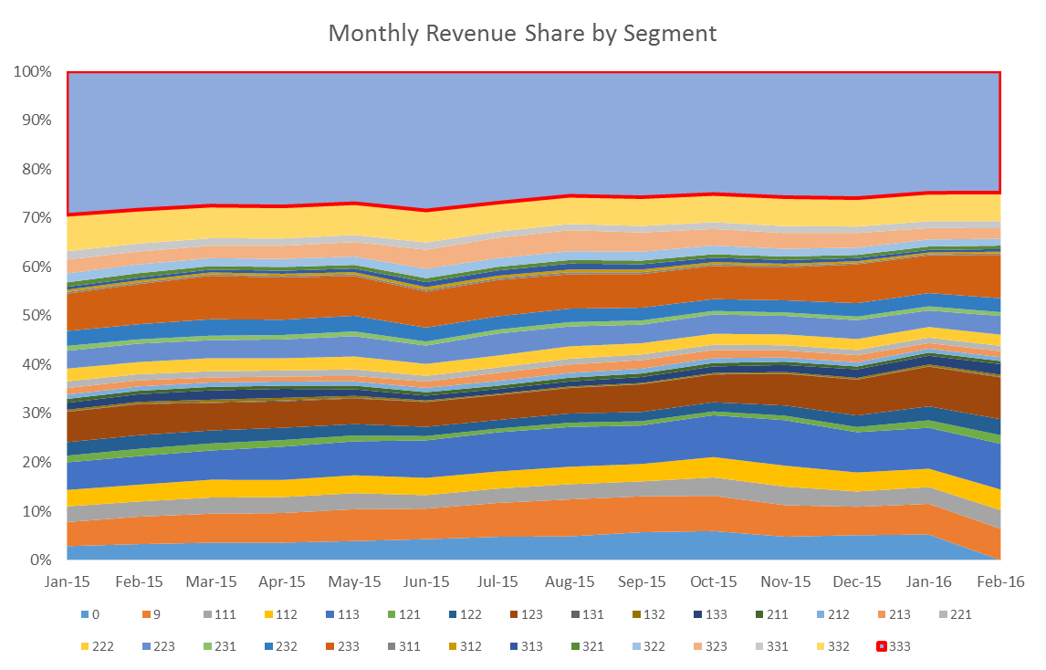
DATA EXPLORATION – revenue contribution
The ‘Best’ segment accounts for ~25% of monthly revenue with 4.25% of the membership base. Small fluctuations in conversion or trips per member can have large revenue effects

Slide 11
DATA EXPLORATION – revenue per reservation
As the number of reservations a member takes in a six month period increases, the average revenue per reservation slowly declines

Slide 12
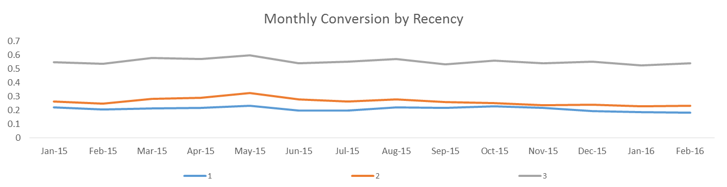
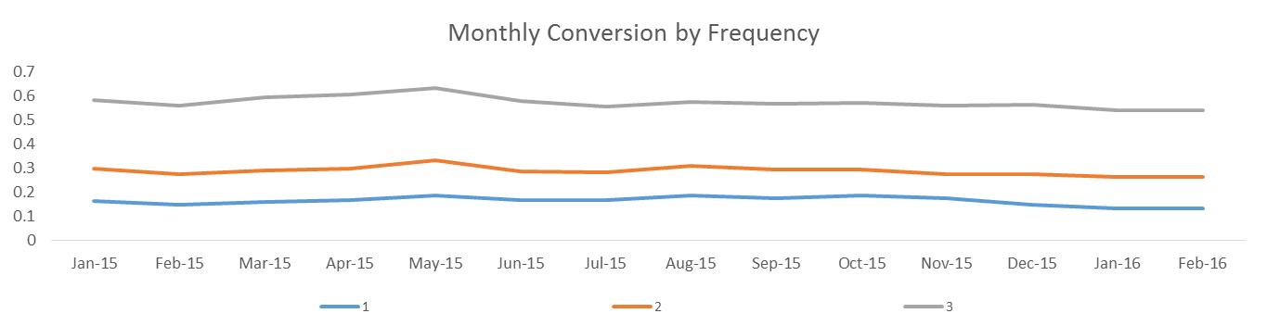
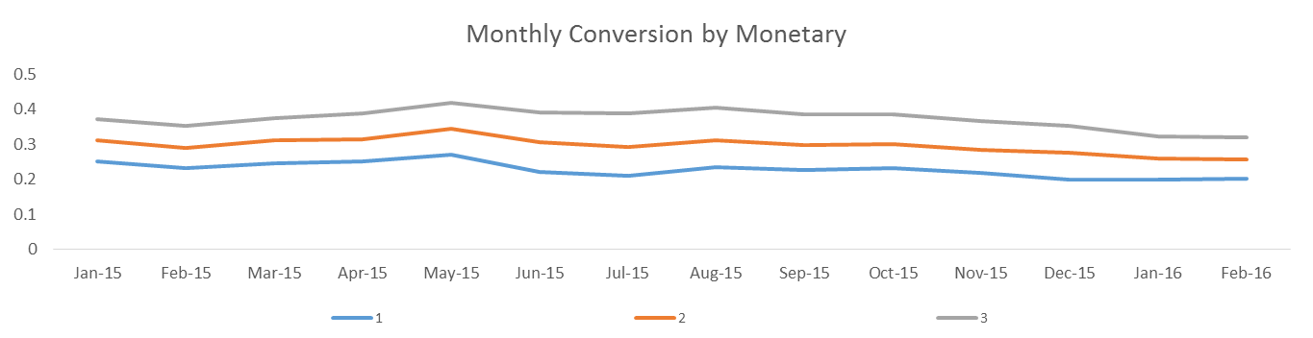
DATA EXPLORATION – conversion trends

Slide 13
Data exploration - findings
Recency and Frequency are strongly correlated to current behavior
Monthly spend not as strong an indicator
Challenges
Breakpoints were somewhat arbitrarily chosen
Difficult for new and inactive members to move to ‘best’ member class quickly
Similarly, moving the Frequency segment a slow process

Slide 14

Data exploration – FINDINGS/ASSUMPTIONS
Breakpoints were somewhat arbitrarily chosen
Can we model out the incremental impact of these indicators?
Difficult for new and inactive members to move to ‘best’ member class quickly
Similarly, moving the Frequency segment a slow process
Will the distribution of members by probability be sufficiently stratified for us to target and measure impact?
Build a logistic model to choose predictors and understand impact. Use this subset for subsequent ML modeling.

Slide 15
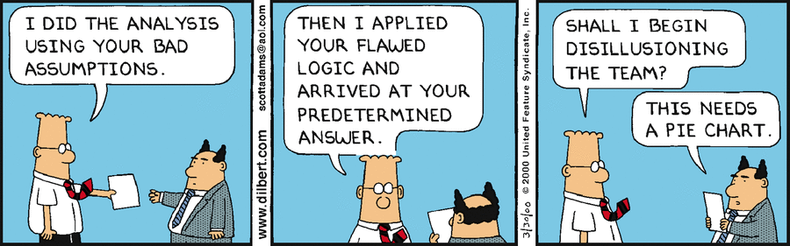
Data exploration - FINDINGS/ASSUMPTIONS
Average Revenue not a great indicator.
Leverage CP findings – members who take multiple type of reservations most likely to be high value
Declining revenue per reservation – perceived value? Can we capture that in the data somehow?

Slide 16
MODELING – VARIABLE SELECTION
Potential Predictor Variables
Reservations | Web Res | App Res | Hourly Res
Daily Res | Overnight Res | Web Res Share | App Res Share
Hourly Res Share | Daily Res Share | Overnight Res Share | Hours
Used Hours | Distance | Rev/Res | Utilization
Membership Length | Last Rented | Zipfleet | Business Segment
Rate plan | Current Month
How varied were the types of reservations
Hours in car/total res hours

Slide 17
MODELING – VARIABLE SELECTION
Snapshot all members from July 2013 through March 2016, capturing their ‘current’ month usage behavior, and previous six months usage.
24.7 Million observations
Hold out all February Data
Hold out all March Data
Twenty percent random sample of remaining observations (~4.5M)
Split sample 75/25
Use the 75% to train the model
Test against 25% holdout
Test against February
Test against March

Slide 18
MODELING – VARIABLE SELECTION
Potential Predictor Variables
Reservations | Web Res | App Res | Hourly Res
Daily Res | Overnight Res | Web Res Share | App Res Share
Hourly Res Share | Daily Res Share | Overnight Res Share | Hours
Used Hours | Distance | Rev/Res | Utilization
Membership Length | Last Rented | Zipfleet | Business Segment
Rate plan | Current Month
The ‘base’ case is likelihood of a Philadelphia Member on the Annual Plan with no reservations in the previous 6 months to make a reservation in July.

Slide 19

Modeling – notable variables
Did Reserve? = -2.943 + (Reservations * 0.07708) +(Daily_Reservations * 0.01786) +(Web_Res_Share * 0.05044) +(App_Res_Share * 0.1037) +(Daily_Res_Share * -0.08512) +(Overnight_Res_Share * 0.00743) +(Rented_Hours * 0.0005669) +(Distance_Driven * 0.0001096) +(RevPerRes * -0.001933) +(MONTHS.TO.CURRENT * -0.001228) +(Last_Rent1 * 2.582) +(Last_Rent2 * 1.752) +(Last_Rent3 * 1.382) +(Last_Rent4 * 1.14) +(Last_Rent5 * 0.9136) +(Last_Rent6 * 0.7961) +(ZIPFLEETatlanta_region * -0.1941) +(ZIPFLEETaustin_region * -0.3264) +(ZIPFLEETbaltimore_region * 0.02868) +(ZIPFLEETboston_region * 0.01851) +(ZIPFLEETchicago_region * 0.02291) +(ZIPFLEETcountry_ca_agencies * -5.551) +(ZIPFLEETcountry_us_agencies * -0.1368) +(ZIPFLEETcountry_us_airports * -0.5852) +(ZIPFLEETdallas_region * -0.07629) +(ZIPFLEETdc_region * -0.06626) +(ZIPFLEETdenver_region * -0.2667) +(ZIPFLEETdetroit_region * 0.03958) +(ZIPFLEETfleet_canada_template * -5.599) +(ZIPFLEETfleet_montreal_qc * -5.555) +(ZIPFLEETfleet_old_flexcar_denver * -5.522) +(ZIPFLEEThawaii_region * 0.7026) +(ZIPFLEEThouston_region * -0.1486) +(ZIPFLEETlos_angeles_region * -0.2434) +(ZIPFLEETmiami_region * -0.1849) +(ZIPFLEETmilwaukee_region * -0.04614) +(ZIPFLEETminneapolis_region * -0.1404) +(ZIPFLEETny_region * 0.00669) +(ZIPFLEETpittsburgh_region * -0.1394) +(ZIPFLEETportland_region * -0.1008) +(ZIPFLEETprovidence_region * -0.07983) +(ZIPFLEETsacramento_region * -0.1381) +(ZIPFLEETsan_diego_region * -0.1847) +(ZIPFLEETsanfrancisco_region * -0.03813) +(ZIPFLEETseattle_region * -0.06887) +(ZIPFLEETtoronto_region * 0.08688) +(ZIPFLEETvancouver_region * -0.01278) +(BUSINESS.SEGMENTBusiness * -0.07019) +(BUSINESS.SEGMENTCollegiate * -0.03268) +(RATEPLANbimonthly * 0.04964) +(RATEPLANmonthly * 0.1188) +(CurrentMonth01 * -0.09764) +(CurrentMonth02 * -0.08711) +(CurrentMonth03 * 0.08477) +(CurrentMonth04 * 0.09282) +(CurrentMonth05 * 0.2215) +(CurrentMonth06 * -0.01787) +(CurrentMonth08 * 0.119) +(CurrentMonth09 * -0.008868) +(CurrentMonth10 * 0.03289) +(CurrentMonth11 * -0.01483) +(CurrentMonth12 * -0.07934)
KEY PREDICTORS* | ODDS RATIO
Reservation last month | 1222%
Reservation 2 months prior | 477%
Reservations | 8%
Monthly Rate Plan | 13%
Daily Res Share | -8.2%
% of Reservations made through App | 10.9%
% of Reservations made through Web | 5.2%
Revenue/Reservation | -0.2%
*Full list available in appendix

Slide 20
MODEL VALIDATION
Test Sample | Actual No Res | Actual Res
Predicted No Res | 879,764 | 131,366
Predicted Res | 39,462 | 89,727
85% Overall Accuracy
40% True Positive Rate
95% True Negative Rate
February Actual | Actual No Res | Actual Res
Predicted No Res | 660,770 | 80,096
Predicted Res | 20,263 | 48,631
88% Overall Accuracy
38% True Positive Rate
97% True Negative Rate
March Actual | Actual No Res | Actual Res
Predicted No Res | 614,223 | 67,604
Predicted Res | 29,259 | 60,577
87% Overall Accuracy
47% True Positive Rate
95% True Negative Rate

Slide 21
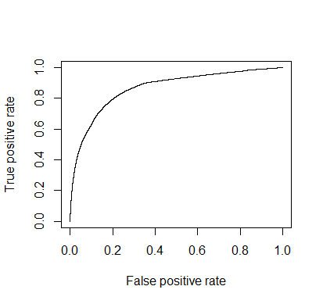
MODEL VALIDATION
What if we lower the ‘Success’ Threshold from 50% to 40%?
March Actual | Actual No Res | Actual Res
Predicted No Res | 585,033 | 50,529
Predicted Res | 58,449 | 77,652
86% Overall Accuracy
61% True Positive Rate
91% True Negative Rate
We can use the ROC curve above to determine breakpoints for segmenting users. In the following example, four segments have been defined

Slide 22
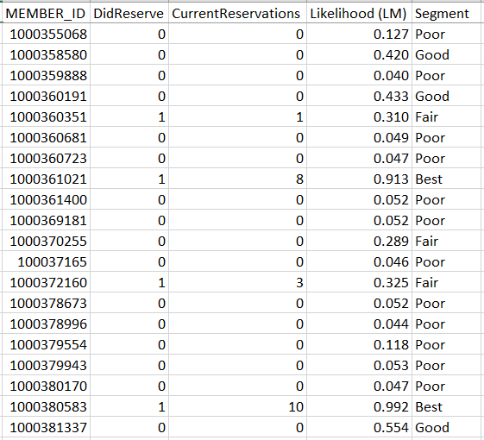
VALIDATION – march detail
All members are given a score of 0 to 1 that represents their predicted likelihood to make a reservation that month. The table below shows a four-tiered segmentation plan
Segment | Criteria | Total Members | Reserving Members | Conversion
Best | > .080 | 19,967 | 16,803 | 84%
Good | > .040 and <.080 | 116,134 | 60,849 | 52%
Fair | > .020 and < .040 | 132,363 | 22,627 | 26%
Poor | < .020 | 549,464 | 27,902 | 5.1%

Slide 23

VALIDATION - SUMMARY
This segmentation strategy presents the ability to dynamically define segments to dial in or broadly approach groups of members.
Generally we need to maintain at the ‘Best’ segment
The ‘Good’ segment provides many opportunities to gain incremental conversions

Slide 24
RESERVATION PREDICTION MODEL
If we can have some success predicting whether members will drive or not, can we predict how many reservations they will actually make?
Same approach, create a linear regression model targeting monthly reservations (vs. a logistic regression)
In the aggregate, results are promising: February within 9.8% of actual reservations (372,284* actual vs. 335,261 predicted)
*Historical Overview shows 382K total reservations, 329 reservations for February. Currently investigating the variances between these numbers.

Slide 25
RESERVATION MODEL RESULTS
Aggregate results are positive, but how did the model perform at the individual level?
Results are a little misleading; driven by high number of 0 reserving members. How did we do on members making more than 1 reservation?
Prediction Within | Total Members | %
<=1 | 706,727 | 87%
<=2 | 769,730 | 95%
<=5 | 801,504 | 99%
Prediction Within | Total Members | %
<=1 | 19,623 | 30%
<=2 | 46,046 | 61%
<=5 | 68,420 | 90%

Slide 26
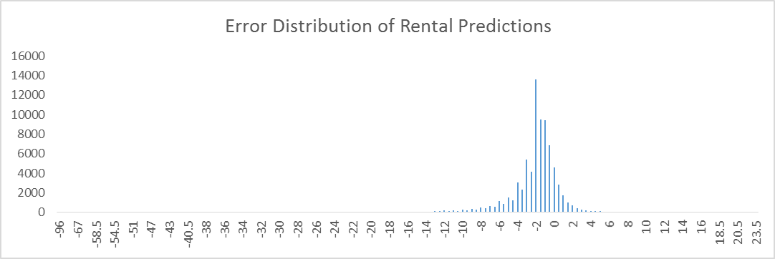
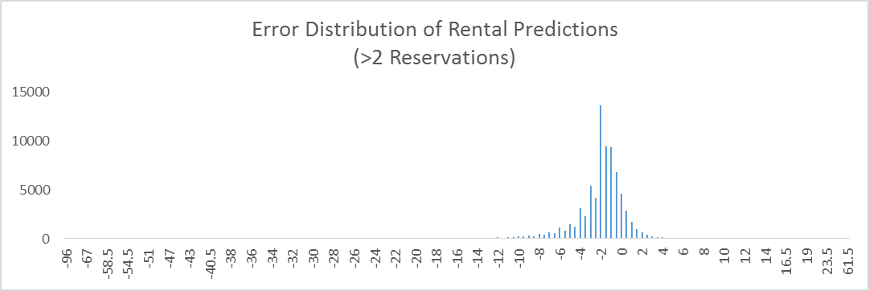
RESERVATION MODEL VALIDATION

Slide 27
Next Steps
Build out additional models
Random Forest
GBM
Neural Net
Naïve Bayes
Resolve discrepancies in reservation totals
Research additional predictor variables
time to first drive
cancellations
tickets
nps
fuel fillups
renewal date/time to renewal
email
social*
app/web usage*
Figure out how to productionize (automate and deploy)

Slide 28
Next Steps (cont.)
Use cases
How do all three segmentation strategies work together? (CP/RFM/Probability)
Observe
Do predictions themselves become a meta-layer for classification? Do certain members repeatedly behave against/with class? Are certain members unpredictable?
Re-factor
Use domain expertise to identify commonalities amongst miscast (both positive and negative) members and provide additional specification to the modeling function.

Slide 29
Next Steps
Question/Comments?

Slide 30
APPENDIX A: LOGISTIC MODEL COEFFICIENTS
Coefficients:
Estimate Std. Error z value Pr(>|z|) Odds Ratio
(Intercept) -2.943 0.012 -250.915 < 2e-16
Reservations 0.077 0.000 160.56 < 2e-16 8.0%
Daily_Reservations 0.018 0.002 8.067 7.22E-16 1.8%
Web_Res_Share 0.050 0.007 7.517 5.62E-14 5.2%
App_Res_Share 0.104 0.007 15.166 < 2e-16 10.9%
Daily_Res_Share -0.085 0.010 -8.769 < 2e-16 -8.2%
Overnight_Res_Share 0.007 0.014 0.545 0.585518 0.7%
Rented_Hours 0.001 0.000 8.079 6.52E-16 0.1%
Distance_Driven 0.000 0.000 11.811 < 2e-16 0.0%
RevPerRes -0.002 0.000 -36.688 < 2e-16 -0.2%
MONTHS.TO.CURRENT -0.001 0.000 -20.013 < 2e-16 -0.1%
Last_Rent1 2.582 0.008 338.115 < 2e-16 1222%
Last_Rent2 1.752 0.008 216.338 < 2e-16 477%
Last_Rent3 1.382 0.009 156.48 < 2e-16 298%
Last_Rent4 1.140 0.010 117.645 < 2e-16 213%
Last_Rent5 0.914 0.011 84.867 < 2e-16 149%
Last_Rent6 0.796 0.012 67.312 < 2e-16 122%
ZIPFLEETatlanta_region -0.194 0.019 -10.395 < 2e-16 -18%
ZIPFLEETaustin_region -0.326 0.029 -11.182 < 2e-16 -28%
ZIPFLEETbaltimore_region 0.029 0.017 1.731 0.083368 3%
ZIPFLEETboston_region 0.019 0.011 1.711 0.08717 2%
ZIPFLEETchicago_region 0.023 0.011 1.995 0.046092 2%
ZIPFLEETcountry_ca_agencies -5.551 17.940 -0.309 0.756969 -100%
ZIPFLEETcountry_us_agencies -0.137 0.011 -11.952 < 2e-16 -13%
ZIPFLEETcountry_us_airports -0.585 0.095 -6.19 6.03E-10 -44%
ZIPFLEETdallas_region -0.076 0.029 -2.603 0.009247 -7%
ZIPFLEETdc_region -0.066 0.011 -5.878 4.16E-09 -6%
ZIPFLEETdenver_region -0.267 0.046 -5.813 6.13E-09 -23%
ZIPFLEETdetroit_region 0.040 0.037 1.057 0.290539 4%
ZIPFLEETfleet_canada_temp -5.599 43.950 -0.127 0.898634 -100%
ZIPFLEETfleet_montreal_qc -5.555 19.650 -0.283 0.777391 -100%
ZIPFLEETfleet_old_flexcar_den -5.522 31.070 -0.178 0.858947 -100%
ZIPFLEEThawaii_region 0.703 0.405 1.736 0.082577 102%
ZIPFLEEThouston_region -0.149 0.042 -3.545 0.000393 -14%
ZIPFLEETlos_angeles_region -0.243 0.015 -16.543 < 2e-16 -22%
ZIPFLEETmiami_region -0.185 0.031 -5.92 3.22E-09 -17%
ZIPFLEETmilwaukee_region -0.046 0.034 -1.347 0.177934 -5%
ZIPFLEETminneapolis_region -0.140 0.040 -3.498 0.000468 -13%
ZIPFLEETny_region 0.007 0.010 0.645 0.519114 1%
ZIPFLEETpittsburgh_region -0.139 0.022 -6.381 1.76E-10 -13%
ZIPFLEETportland_region -0.101 0.015 -6.809 9.81E-12 -10%
ZIPFLEETprovidence_region -0.080 0.021 -3.825 0.000131 -8%
ZIPFLEETsacramento_region -0.138 0.028 -5.018 5.22E-07 -13%
ZIPFLEETsan_diego_region -0.185 0.026 -7.022 2.18E-12 -17%
ZIPFLEETsanfrancisco_region -0.038 0.011 -3.489 0.000485 -4%
ZIPFLEETseattle_region -0.069 0.013 -5.282 1.28E-07 -7%
ZIPFLEETtoronto_region 0.087 0.012 7.222 5.14E-13 9%
ZIPFLEETvancouver_region -0.013 0.017 -0.765 0.444097 -1%
BUSINESS.SEG.Business -0.070 0.005 -15.428 < 2e-16 -7%
BUSINESS.SEG.Collegiate -0.033 0.005 -6.281 3.36E-10 -3%
RATEPLANbimonthly 0.050 0.067 0.736 0.461937 5%
RATEPLANmonthly 0.119 0.005 22.387 < 2e-16 13%
CurrentMonth01 -0.098 0.007 -13.22 < 2e-16 -9%
CurrentMonth02 -0.087 0.008 -10.488 < 2e-16 -8%
CurrentMonth03 0.085 0.008 10.346 < 2e-16 9%
CurrentMonth04 0.093 0.008 11.363 < 2e-16 10%
CurrentMonth05 0.222 0.008 27.557 < 2e-16 25%
CurrentMonth06 -0.018 0.008 -2.187 0.028716 -2%
CurrentMonth08 0.119 0.007 16.456 < 2e-16 13%
CurrentMonth09 -0.009 0.007 -1.219 0.222992 -1%
CurrentMonth10 0.033 0.007 4.551 5.34E-06 3%
CurrentMonth11 -0.015 0.007 -2.045 0.040827 -1%
CurrentMonth12 -0.079 0.008 -9.688 < 2e-16 -8%

Slide 31
APPENDIX B: Linear MODEL COEFFICIENTS
Coefficients:
Estimate Std. Error t value Pr(>|t|)
(Intercept) 0.118 0.004 28.097 < 2e-16
Reservations 0.121 0.000 814.043 < 2e-16
Daily_Reservations -0.010 0.001 -14.444 < 2e-16
Web_Res_Share 0.005 0.003 1.856 0.0635
App_Res_Share 0.013 0.003 4.287 1.81E-05
Daily_Res_Share 0.023 0.004 6.195 5.82E-10
Overnight_Res_Share 0.028 0.006 4.531 5.87E-06
Rented_Hours 0.000 0.000 8.872 < 2e-16
Distance_Driven 0.000 0.000 -19.008 < 2e-16
RevPerRes 0.000 0.000 -8.7 < 2e-16
MONTHS.TO.CURRENT -0.001 0.000 -50.183 < 2e-16
Last_Rent1 0.420 0.003 139.68 < 2e-16
Last_Rent2 -0.139 0.003 -42.778 < 2e-16
Last_Rent3 -0.177 0.003 -50.733 < 2e-16
Last_Rent4 -0.169 0.004 -45.733 < 2e-16
Last_Rent5 -0.151 0.004 -38.776 < 2e-16
Last_Rent6 -0.102 0.004 -25.002 < 2e-16
ZIPFLEETatlanta_region -0.018 0.006 -2.841 0.004501
ZIPFLEETaustin_region -0.058 0.009 -6.35 2.15E-10
ZIPFLEETbaltimore_region 0.025 0.006 4.063 4.85E-05
ZIPFLEETboston_region 0.006 0.004 1.452 0.146557
ZIPFLEETchicago_region -0.026 0.004 -6.056 1.40E-09
ZIPFLEETcountry_ca_agencies -0.040 0.439 -0.09 0.927951
ZIPFLEETcountry_us_agencies -0.022 0.004 -5.134 2.83E-07
ZIPFLEETcountry_us_airports -0.093 0.025 -3.7 0.000216
ZIPFLEETdallas_region 0.023 0.011 2.108 0.035053
ZIPFLEETdc_region -0.017 0.004 -4.117 3.84E-05
ZIPFLEETdenver_region -0.029 0.015 -1.986 0.047002
ZIPFLEETdetroit_region 0.124 0.014 8.679 < 2e-16
ZIPFLEETfleet_canada_temp -0.102 1.074 -0.095 0.924452
ZIPFLEETfleet_montreal_qc -0.090 0.620 -0.145 0.885088
ZIPFLEETfleet_old_flexcar_den 0.011 0.760 0.015 0.988104
ZIPFLEEThawaii_region 0.043 0.155 0.274 0.783875
ZIPFLEEThouston_region -0.016 0.015 -1.114 0.265185
ZIPFLEETlos_angeles_region -0.042 0.005 -8.247 < 2e-16
ZIPFLEETmiami_region -0.021 0.011 -1.982 0.047446
ZIPFLEETmilwaukee_region 0.024 0.012 1.962 0.049817
ZIPFLEETminneapolis_region -0.020 0.014 -1.418 0.156077
ZIPFLEETny_region -0.022 0.004 -5.669 1.44E-08
ZIPFLEETpittsburgh_region -0.044 0.008 -5.763 8.28E-09
ZIPFLEETportland_region -0.005 0.005 -1.01 0.312401
ZIPFLEETprovidence_region -0.017 0.008 -2.271 0.023158
ZIPFLEETsacramento_region -0.019 0.009 -1.973 0.048553
ZIPFLEETsan_diego_region -0.021 0.009 -2.33 0.01979
ZIPFLEETsanfrancisco_region -0.026 0.004 -6.327 2.50E-10
ZIPFLEETseattle_region -0.026 0.005 -5.452 4.97E-08
ZIPFLEETtoronto_region 0.017 0.005 3.683 0.000231
ZIPFLEETvancouver_region 0.011 0.006 1.824 0.068191
BUSINESS.SEGMENTBus 0.002 0.002 1.284 0.199287
BUSINESS.SEGMENTColl -0.001 0.002 -0.564 0.572433
RATEPLANbimonthly 0.093 0.020 4.579 4.66E-06
RATEPLANmonthly 0.074 0.002 36.138 < 2e-16
CurrentMonth01 -0.034 0.003 -13.156 < 2e-16
CurrentMonth02 -0.042 0.003 -14.427 < 2e-16
CurrentMonth03 0.019 0.003 6.598 4.16E-11
CurrentMonth04 0.018 0.003 6.261 3.81E-10
CurrentMonth05 0.057 0.003 19.642 < 2e-16
CurrentMonth06 -0.009 0.003 -3.054 0.002258
CurrentMonth08 0.029 0.003 10.963 < 2e-16
CurrentMonth09 -0.012 0.003 -4.769 1.85E-06
CurrentMonth10 0.015 0.003 5.711 1.13E-08
CurrentMonth11 -0.009 0.003 -3.378 0.00073
CurrentMonth12 -0.023 0.003 -7.879 3.31E-15

